Slide 1
Fractal Jerusalem Cross-Based FSS for X-Band Applications
By:
Koustabh Ram Kandula
Anurag Sonar
Dr. Rajesh Natarajan

Slide 2
Contents
Introduction to Frequency Selective Surfaces
Need for Frequency Selective Surfaces
Types of Frequency Selective Surfaces
Literature Review
Problem Formulation
Proposed System
Description
Result Analysis
Conclusion
Individual Contribution
References

Slide 3
Introduction to Frequency Selective Surfaces
Definition: FSS are periodic structures that filter electromagnetic waves by allowing, blocking, or reflecting specific frequencies.
Structure: Made of conductive or dielectric elements (e.g., patches, slots, dipoles) arranged in a periodic pattern.
Function in Antennas: Improve bandwidth and radiation control. Reduce interference and enhance signal quality. Act as spatial filters, reflectors, or radomes.
Applications: Satellite communication and radar systems. Wireless networks and reconfigurable antennas. Electromagnetic shielding and stealth technology.
Advancement: Enables compact, high-performance antennas for modern communication and sensing systems.

Slide 4
Introduction to Frequency Selective Surfaces
Working Principle:
Operate similarly to filters in electrical circuits.
Use resonance effects: elements resonate at particular frequencies, allowing
or blocking specific waves.
Types of FSS Elements:
Patch type (reflective): Blocks certain frequencies.
Slot type (transmissive): Allows certain frequencies through.
Key Parameters:
Element shape (e.g., dipole, ring, square)
Periodicity
Substrate properties
Incident angle and polarization

Slide 5
Need for Frequency Selective Surfaces
Electromagnetic Filtering: FSS structures act like spatial filters, allowing or blocking specific frequency bands — crucial in X-band applications (8–12 GHz).
Compact & Planar Design: Ideal for integration into modern, low-profile systems such as radomes, antennas, and stealth platforms.
Enhanced Performance: Improve system efficiency by minimizing interference, reflections, and unwanted signal propagation.
Reconfigurability & Scalability: FSS can be tailored for specific applications — adaptable using fractal geometries like the Jerusalem cross for multiband and miniaturized designs.
Cost-Efficient & Lightweight: Passive and low-maintenance, making them perfect for aerospace, defense, and 5G applications.

Slide 6
Types of Frequency Selective Surfaces
Band-pass FSS
Allows transmission of a specific frequency band
Blocks all other frequencies
Used in applications requiring selective signal passage (e.g., satellite comms)
Band-stop (Notch) FSS
Blocks a specific frequency band
Allows others to pass through
Ideal for interference mitigation and RCS reduction
Low-Pass FSS
Passes low-frequency signals
Reflects higher frequencies
Useful in shielding high-frequency noise
4. High-Pass FSS
Passes high-frequency signals
Blocks low-frequency components
Common in wide-band or radar applications!

Slide 7
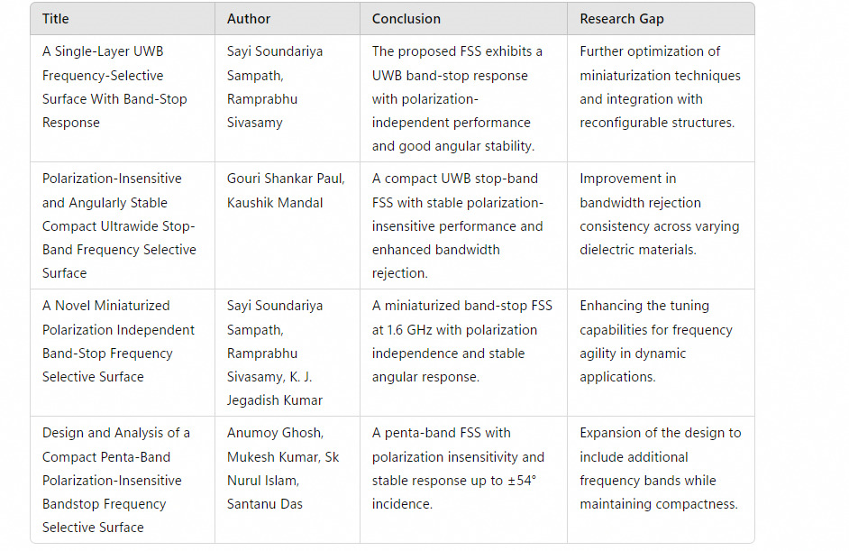
Literature Review

Slide 8
Problem Formulation
Limitations of Standard Shapes: The basic Jerusalem cross was found inadequate in achieving broad stop-bands and deep notches, showing only narrow-band behavior centered around 11 GHz.
Need for Enhanced Resonance Paths: Traditional geometries lacked complexity, limiting their interaction with electromagnetic waves and reducing effectiveness for multi-band applications.
Fractal Geometry as a Solution: The fractal Jerusalem cross was chosen to introduce recursive, self-similar structures, increasing the number of resonant paths and improving frequency selectivity.
Shape’s Role in Angular & Polarization Stability: The symmetrical, fractal layout of the chosen shape inherently supports TE/TM stability and high angular tolerance, addressing performance gaps in earlier designs.

Slide 9
Proposed System
Fractal Jerusalem Cross Geometry: Utilizes a self-similar, multi-scale structure to increase electrical length and support multi-band resonance with enhanced frequency selectivity.
Symmetrical Layout: Ensures polarization insensitivity and angular stability for both TE and TM waves, effective up to 75° incidence.
Design Evolution: Transitioned from a basic Jerusalem cross to a fractal configuration, significantly broadening stopband width and improving notch depth.
Double-Sided Implementation: Further boosts performance by enhancing wave interaction and achieving deeper S21 transmission nulls across a wide frequency band.
Compact and Scalable: Maintains a single-layer structure with fabrication simplicity, while offering potential for integration into advanced, low-profile wireless systems.

Slide 10
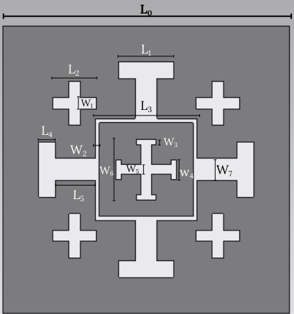
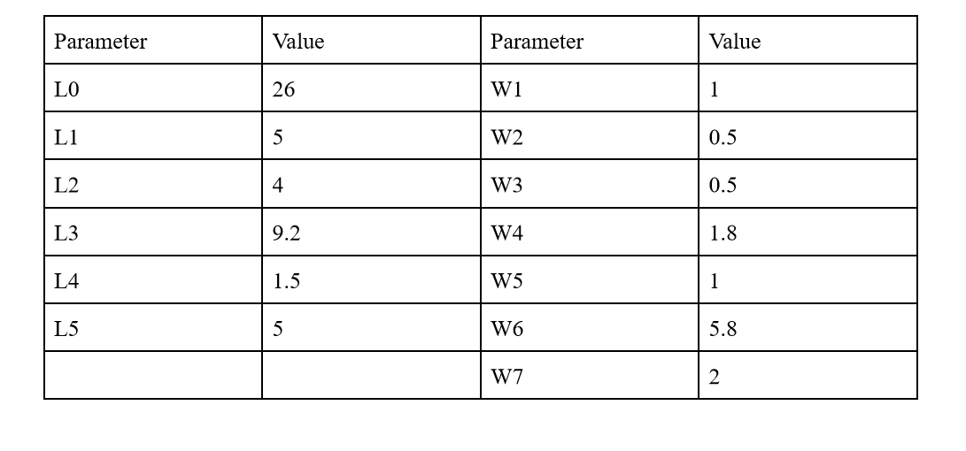
Proposed System (Contd.)

Slide 11
Description
Core Structure: Central Jerusalem cross with extended arms serves as the primary resonator for electromagnetic filtering.
Embedded Self-Similar Cross: A smaller cross is nested at the center of the main structure, introducing fractal properties and enabling multi-band resonance.
Peripheral Mini Crosses: Four small crosses are symmetrically placed near each corner of the unit cell, reinforcing the fractal geometry and adding higher-order resonant paths.
Role of Mini Crosses: These peripheral elements enhance electromagnetic interaction, deepen notches in transmission (S21), and broaden the stopband in reflection (S11), especially critical for wideband performance.
Symmetry & Stability: The symmetrical distribution of all elements — including the mini crosses — contributes to polarization insensitivity and stable behavior at oblique incidence angles.

Slide 12
Result Analysis
Broadband Performance Achieved: The S11 plot shows a wide stopband ranging approximately from 6 GHz to over 20 GHz, confirming effective reflection suppression.
Deep Multi-band Notches: S21 plots reveal strong attenuation at multiple frequencies (notably 7–9 GHz and 10–11 GHz), demonstrating successful multi-resonant behavior.
Enhanced Angular Stability: Both TE and TM modes maintained consistent performance up to 75° incidence, validating the design’s robustness to oblique angles.
Improved Transmission Suppression: The two-sided fractal layout resulted in transmission dips exceeding –40 dB (TE) and –60 dB (TM), indicating strong electromagnetic shielding.

Slide 13
Results Analysis Contd.

Slide 14
Results Analysis Contd.

Slide 15
Results Analysis Contd.

Slide 16
Results Analysis Contd.

Slide 17
Conclusion
Fractal Geometry Success: The fractal Jerusalem cross design significantly outperformed the standard version by offering broadband and multi-band rejection capabilities.
Robust Angular and Polarization Performance: Consistent S11 and S21 results across wide angles and both TE/TM polarizations confirm the design’s angular stability and polarization insensitivity.
Effective for Real-world Applications: The two-sided implementation enhances shielding and filtering, making the design ideal for stealth, EMI suppression, and smart sensing platforms.
Scalable and Manufacturable: Maintains a single-layer structure that balances complexity with ease of fabrication, suitable for compact and multilayer system integration.
Future Potential: The design’s scalability opens doors for use in IoT devices, next-gen wireless networks, and aerospace systems requiring lightweight, multifunctional surfaces.

Slide 18
Individual Contribution
Koustabh Ram Kandula
Literature Survey
Structure and Simulation
Anurag Sonar
Material Research
Presentation and Documentation

Slide 19
References
B.A. Munk, Frequency Selective Surfaces: Theory and Design. Hoboken, NJ, USA: John Wiley & Sons, 2000.
2. R.J. Langley, E.A. Parker, and T. Arabadzhiyska, “Frequency selective surfaces—a review,” IEE
Proceedings-Microwaves, Antennas and Propagation, vol. 145, no. 3, pp. 213-218, 1998. 3. W.C. Chew, “Frequency selective surfaces,” in Waves and Fields in Inhomogeneous Media, Hoboken,
NJ, USA: IEEE Press, 1995, pp. 568-601. (For access, search the book title on IEEE Xplore or usWorldCat:) 4. E.A. Parker, P.H. El Sheikh, and R.J. Langley, “Wire-element frequency selective surfaces,” IEE
Proceedings H - Microwaves, Antennas and Propagation, vol. 138, no. 3, pp. 165-170, 1991. 5. R. Cahill and R.J. Langley, “Cross-shaped frequency selective surfaces,” IEE Proceedings-Microwaves,
Antennas and Propagation, vol. 141, no. 4, pp. 275-278, 1994. 6. D.H. Werner, S. Ganguly, and M.A. Khalid, “Fractal antenna engineering: the space filling Hilbert
curve,” IEEE Antennas and Propagation Magazine, vol. 45, no. 5, pp. 38-49, 2003.

